Slide 1
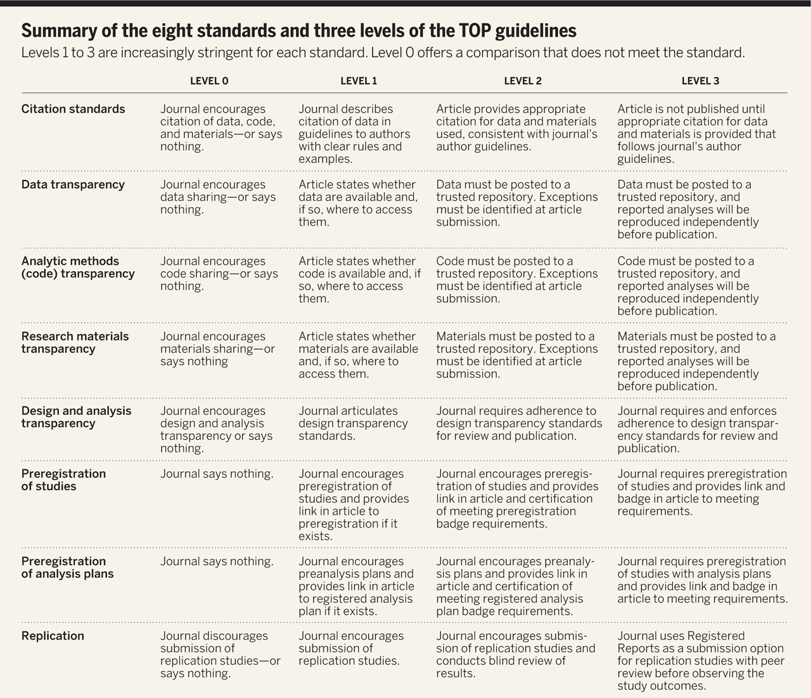

Summary of the eight standards and three levels of the TOP guidelines Levels 1 to 3 are increasingly stringent for each standard.
B. A. Nosek et al. Science 2015;348:1422-1425
Published by AAAS
Notes:
Summary of the eight standards and three levels of the TOP guidelines Levels 1 to 3 are increasingly stringent for each standard. Level 0 offers a comparison that does not meet the standard.

